Slide 1
How can Blockchain revolutionize the proof of existence of unregistered IP rights worldwide?
Vincent Fauchoux
Partner / Deprez Guignot Associés
Co-founder and Partner / BlockchainyourIP
LOGO

Slide 2
THE ISSUE OF UNREGISTERED IP RIGHT’S PROOF OF EXISTENCE
Intellectual property rights are divided into two categories: registered and unregistered rights. Within each country around the world, the legal framework of each right could be differently assessed.
Registered rights
Patent
Trademark
Registered design
These rights are materialized by an official dated title (e.g. a patent, trademark or design certificate).
Unregistered rights
Copyright
Unregistered design (e.g. EU and UK
Trade dress (U.S.)
Trade secret and knowhow
Trade name
These rights are NOT materialized by any official dated title.

Slide 3
THE RISKS A COMPANY MAY FACE REGARDING ITS UNREGISTERED IP RIGHTS
CLASSICAL RISKS
GROWING RISKS
Infringers
Unfair competitors
Industrial
espionage
Hackers
Patent trolls & copyright trolls
Indelicate or former employees
Cyberattacks
Business partners
NB: Every registered IP rights were former unregistered IP rights

Slide 4
WHY DO THE UNREGISTERED IP RIGHTS FACE GREATER RISKS OF MISAPPROPRIATION?
Because there is no official record, misappropriation of unregistered IP rights is easier.
When unauthorised disclosure or diversion happens, the asset may loose
All or part of its economic value (e.g. loss of exclusivity);
One of the condition required to get legal protection (e.g. loss of confidentiality for trade secrets and know how).
In 2011, in New York City, a man has been sentenced to a year in prison for
having uploaded a working version of the movie X-Men Origins: Wolverine,
one month before the movie’s release.
In 2014, Madonna has also been victim of hacking, several demos having been published on the Internet.

Slide 5
A SPECIFIC LEGAL FAVOR: NO FORMALITIES ARE REQUIRED TO BENEFIT FROM ANY UNREGISTERED IP RIGHT
The protection of creations or innovations is not subject to the fulfilment of formalities.
Protection of creation
This principle, known as "automatic protection", is one of the three fundamental principles of the 1886 Berne Convention on the protection of works and authors' rights.
Copyright protection is therefore granted automatically without any filling or registration formalities. This principle is applicable in many countries, notably in France.
Protection of innovation
The protection of a know-how or trade secret (e.g. Directive (EU) 2016/943 on the protection of undisclosed know-how and business information (trade secrets) against their unlawful acquisitions, use and disclosure (08,06,2016); the Defend Trade Secret Act (11.05.2016) in the United States), an unregistered design, a trade dress and a trade name are also not subject to the fulfilment of a prior formality.
The issue that might rise from these “privileges” is that some companies might think that they would be sufficient to protect their assets

Slide 6
WORLDWIDE OVERVIEW OF THE EXISTING METHODS IN ORDER TO PROVE THE EXISTENCE OF UNREGISTERED RIGHTS
Several methods exist for the establishment of unregistered IP rights’ proof of existence.
EXISTING « NATIONAL GOOD PRACTICES »
STANDARD BUSINESS DOCUMENT
Bailiff’s report – e.g. France;
Notarial deposit – e.g. Switzerland;
Deposit to an author’s society – e.g.UK, France;
Private company – e.g.UK;
Official national Copyright Office – e.g. China, India, US;
Dated drawings and sketches;
Dated correspondence;
Photographs taken at trade fairs;
Invoices sent to retailers or distributors;
Documents proving that the creation was disclosed under the owner's name (dated press articles, third-party blogs);
Marketing and advertising materials etc.

Slide 7
TRADITIONAL SOLUTIONS DEDICATED TO THE UNREGISTERED IP RIGHT’S PROOF OF EXISTENCE ARE NOT FULLY SATISFACTORY
Limitations of national “good practices”
Limitations of standard business documents
They are linked to national public or private bodies, and are not international by nature;
They usually only cover finalised creations or innovations and are not designed to protect the whole ongoing process of a creation or of an invention;
They are not suitable for collaborative work involving an important member of participants;
They are sometimes expensive.
They are often gathered just before or even during litigation;
They are insufficient to evidence a certain date;
To go further than existing solutions, that are no well-suited in a digital economy, a new approach must be considered...
Proof of existence with the help of the bitcoin Blockchain technology is an innovative approach completing traditional ones.

Slide 8
4 SIMPLE THINGS YOU SHOULD REMEMBER ABOUT THE BITCOIN BLOCKCHAIN TECHNOLOGY
The Bitcoin Blockchain technology is:
An electronic network functioning, with a peer-to-peer technique, as a vast public registry, integrating every transaction carried out by its users since its creation (2009).
These transactions are grouped into blocks that are ordered from the oldest to the most recent.
Each block contains information relating to the previous block so that it is impossible to modify a block without modifying the whole chain of blocks downstream.
Everyone can download the entire Blockchain and check its integrity at any time. The control of the Blockchain is therefore decentralized.

Slide 9
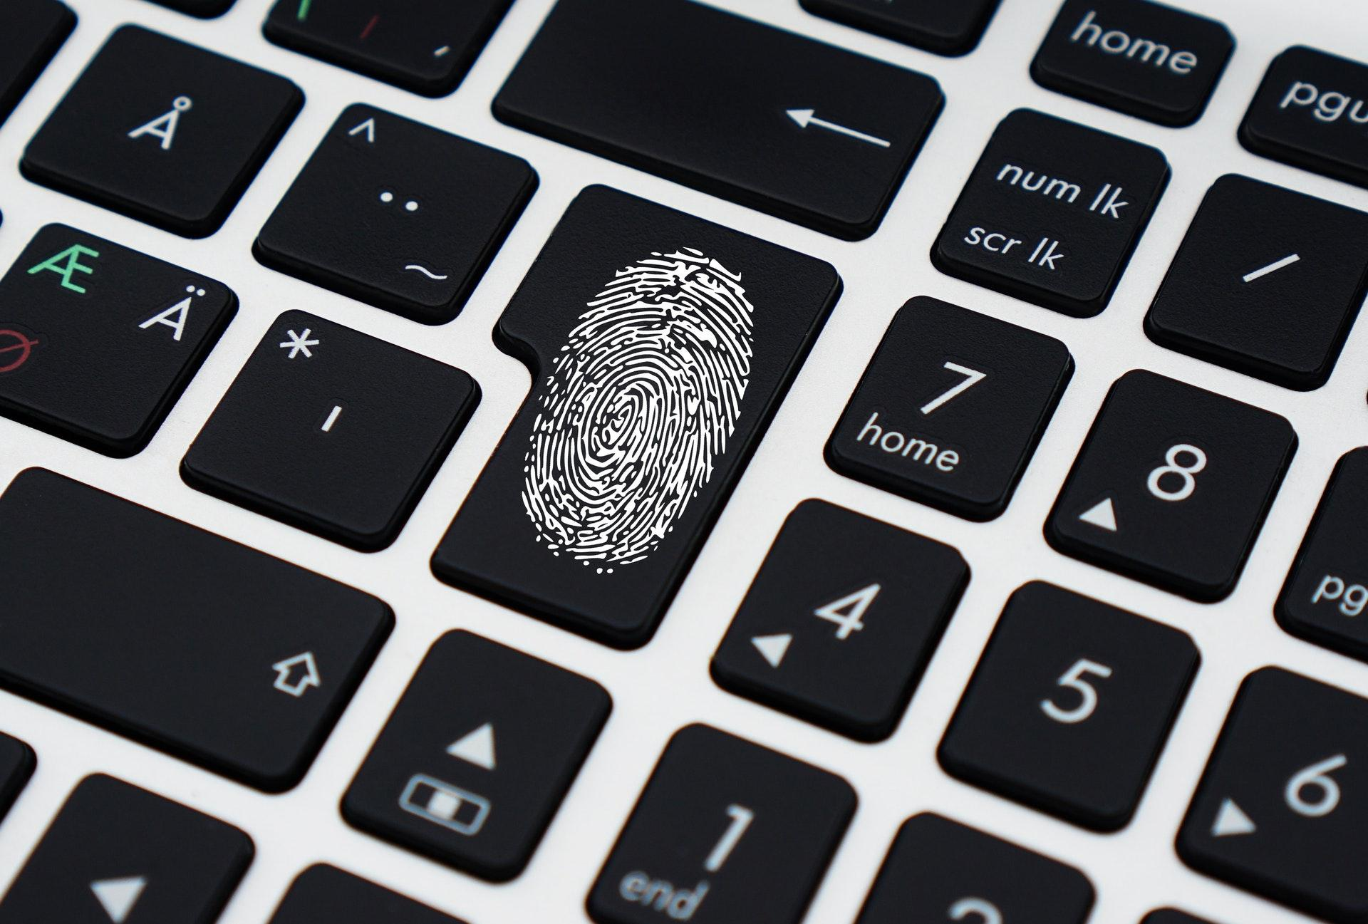
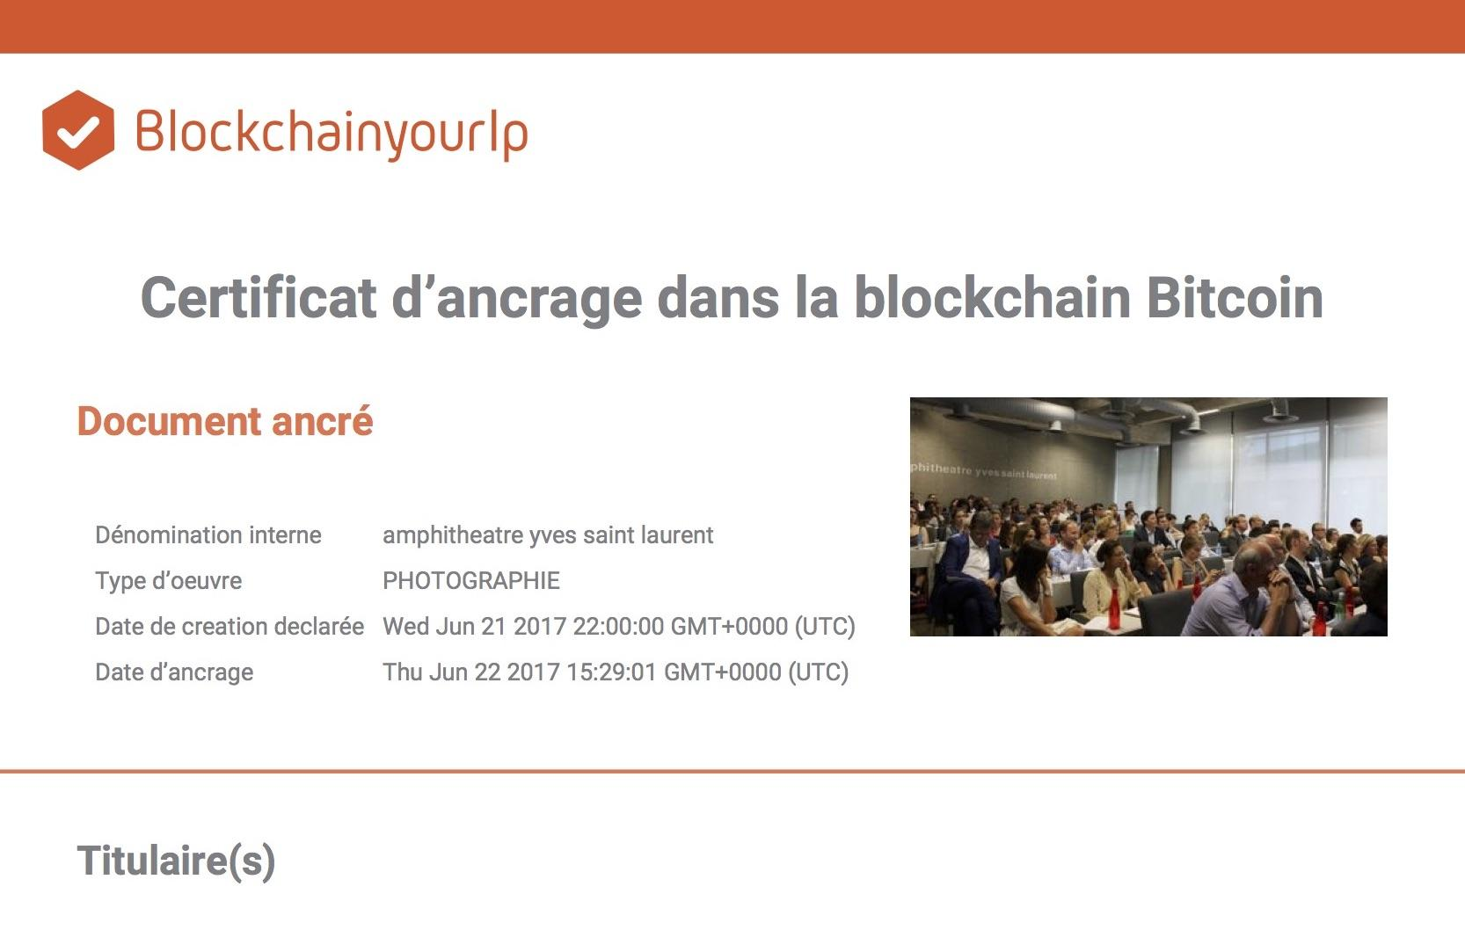
HOW DOES BLOCKCHAIN TECHNOLOGY WORK?
Document
Footprint
Simple
Form
Document
anchoring
Anchor
certificate
Calculates the unique digital print of your document with your browser
Complete a simple form to identify your creation or innovation
The digital print of your document is inserted in a Blockchain bitcoin transaction
Download the certificate proving the protection of your creation or innovation

Slide 10
THE BENEFITS OF BLOCKCHAIN TECHNOLOGY IN IP EVIDENCE
The Bitcoin Blockchain technology offers highly interesting advantages to generate reliable proof of evidence in IP:
Tamper-proof
and secure
Simple
and fast
International
Confidential
Cost-effective
Transparency
The evidence is independently verifiable at any time by anyone with the Bitcoin Blockchain technology with open source Tools.
The evidence is simultaneously recorded on the different "nodes" of the network, making it almost immutable.
The Bitcoin Blockchain generates proof of existence simply and quickly, without the need of a trusted third party.
It is international by nature : it uses a computer protocol which is the same in every country of the world.
The creation or innovation is not disclosed to anyone when the corresponding footprint is calculated and inserted in a Bitcoin Blockchain transaction.
The operating cost are very low.

Slide 11
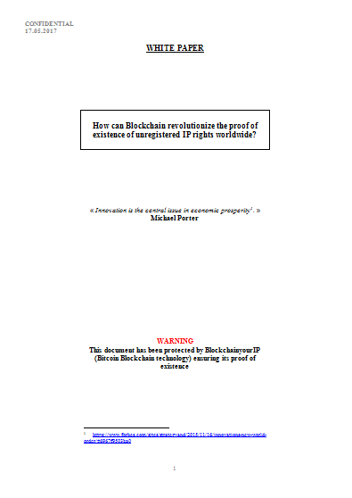
THANK YOU FOR YOUR ATTENTION !
JOIN THE WORLDWIDE MOVEMENT: SUPPORT THE WHITE PAPER INITIATIVE !
The purpose of this document is to explain how Blockchain can revolutionize the proof of existence of unregistered IP rights worldwide.
We strongly believe that Blockchain technology can reinforce the actual protection that unregistered IP rights may benefit from.
Our main objective is to significantly improve the quality of unregistered IP rights’ proof in the digital world.
We would like to share this conviction with as many contributing firms as possible and with a lot of supporters such as companies, professors or universities, on a global scale.

